Slide 1
Feature-Based Alignment and Pose Estimation Techniques

Slide 2
Introduction
In robotics and automation, a system often needs to understand its environment — either by identifying objects, localizing itself, or estimating its own movement.
To do this, feature-based alignment and pose estimation techniques are widely used.
Feature-based alignment means matching distinctive features (keypoints, corners, edges, etc.) between two datasets (images or 3D point clouds) to find their geometric relationship.
Pose estimation refers to finding the position (x, y, z) and orientation (roll, pitch, yaw) of an object or camera with respect to a reference frame.
Together, these techniques help robots and cameras to “see” and “understand” their surroundings.

Slide 3
Classification of Feature-Based Alignment and Pose Estimation Techniques

Slide 4
A. 2D–2D Feature-Based Alignment (Image-to-Image Alignment)
Concept: Used when both datasets are 2D images. The goal is to find the transformation (translation, rotation, scaling, perspective) between two images.
Steps Involved:
Feature Detection: Identify distinct keypoints.
Examples: Harris Corner, SIFT, SURF, ORB, FAST.
Feature Description: Represent each keypoint numerically.
Example: SIFT descriptor (128D vector).
Feature Matching: Match corresponding features between images.
Techniques: Brute-Force, FLANN, RANSAC.
Transformation Estimation: Estimate geometric transform (affine or homography).
Examples:
Aligning aerial images for change detection
Stitching images for panorama creation
Motion tracking between video frames
Applications in Robotics:
Visual odometry (estimating robot motion)
Image mosaicing from UAVs
2D mapping for mobile robots

Slide 5
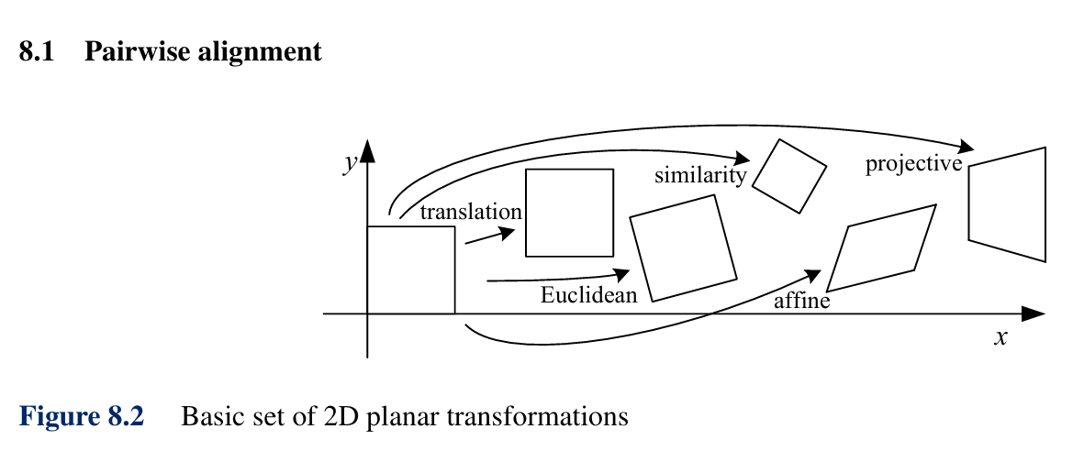

Slide 6
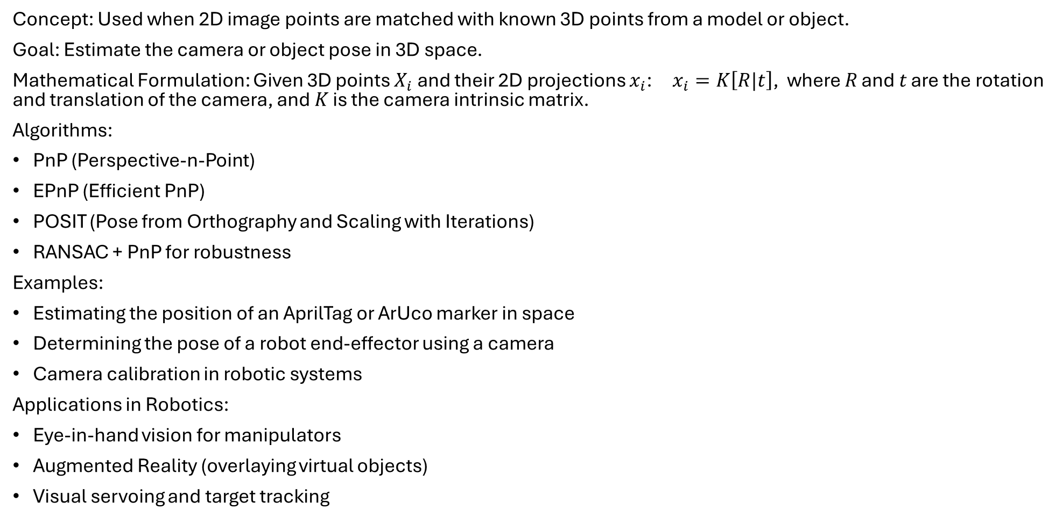
B. 2D–3D Pose Estimation (Image-to-Model Alignment)
Concept: Used when 2D image points are matched with known 3D points from a model or object.
Goal: Estimate the camera or object pose in 3D space.
Mathematical Formulation: Given 3D points $X_{i}$​ and their 2D projections $x_{i}$: $x_{i}=K\left[R|t\right]$, ​where 𝑅 and 𝑡 are the rotation and translation of the camera, and 𝐾 is the camera intrinsic matrix.
Algorithms:
PnP (Perspective-n-Point)
EPnP (Efficient PnP)
POSIT (Pose from Orthography and Scaling with Iterations)
RANSAC + PnP for robustness
Examples:
Estimating the position of an AprilTag or ArUco marker in space
Determining the pose of a robot end-effector using a camera
Camera calibration in robotic systems
Applications in Robotics:
Eye-in-hand vision for manipulators
Augmented Reality (overlaying virtual objects)
Visual servoing and target tracking

Slide 7
C. 3D–3D Alignment (Point Cloud Registration)
Concept: Used when both datasets are 3D point clouds. The objective is to find the rigid-body transformation that aligns one 3D model to another.
Methods:
ICP (Iterative Closest Point): Iteratively aligns two-point clouds by minimizing the distance between corresponding points.
FPFH (Fast Point Feature Histogram): Uses geometric features to find correspondences before alignment.
SHOT descriptors: For robust feature representation in 3D.
Go-ICP: Globally optimal version of ICP.
Examples:
Aligning multiple 3D scans of an object
Registering LiDAR scans for 3D mapping
Merging depth data from stereo or RGB-D cameras
Applications in Robotics:
LiDAR-based SLAM (Simultaneous Localization and Mapping)
3D object recognition
Robotic inspection and reverse engineering

Slide 8
Comparative Summary
Type | Input Data | Typical Algorithms | Output | Applications
2D–2D Alignment | Two 2D images | SIFT, ORB, SURF + RANSAC | Homography or affine transform | Image stitching, visual odometry
2D–3D Pose Estimation | 2D image + 3D model | PnP, EPnP, POSIT | 6D pose (R, t) | Camera localization, AR, visual servoing
3D–3D Alignment | Two 3D point clouds | ICP, Go-ICP, FPFH, SHOT | Rigid-body transform | SLAM, 3D reconstruction, LiDAR mapping

Slide 9
Applications in Automation and Robotics
Area | Application Example | Technique Used
Mobile Robots / AGVs | Localization and path tracking | 2D–2D visual odometry
Manipulator Vision | Eye-in-hand pose estimation | 2D–3D PnP
AR and VR Systems | Object or camera tracking | 2D–3D alignment
Autonomous Vehicles | Sensor fusion (camera + LiDAR) | 3D–3D registration
3D Inspection / Reverse Engineering | Part alignment and comparison | 3D–3D ICP
UAV Mapping | Image mosaicing and geo-alignment | 2D–2D SIFT-based alignment

Slide 10
Conclusion
Feature-based alignment and pose estimation form the foundation of robot perception.
They enable robots to:
Recognize and localize objects
Estimate their own motion
Align multi-view or multi-sensor data
Interact intelligently with the environment.
In essence:
“Feature-based techniques bridge the gap between what the robot sees and how it understands its position and orientation in space.”

